Slide 1
Software Testing Life Cycle for Electronic Product Development
Presented by: GROUP 5
This project explores how software testing is applied in the context of electronic products such as smart speakers, fitness trackers, and home automation devices. The primary focus is on ensuring that embedded software and its interactions with hardware are tested thoroughly to deliver a seamless user experience.
By Coordinator Prince Mishra

Slide 2
Introduction to Software Testing
Software Testing = Evaluating software to verify expected behavior.
Vital for electronics: verifies embedded software in real-world conditions.
Example: Firmware of a smart speaker managing Bluetooth and audio.
Software testing is a critical activity in the development life cycle of any technology product. It refers to the process of evaluating the functionality of a software application to verify that it meets the specified requirements and to ensure that it is free of defects. In the context of electronics, software testing also involves verifying that the firmware or embedded software works correctly with the hardware components.
For example, a smart speaker’s firmware must handle tasks like voice recognition, audio output, Bluetooth connectivity, and Wi-Fi synchronization. If any of these components fail due to software errors, the product could receive negative user feedback or even face recalls. Hence, rigorous testing is essential.
By Coordinator Prince Mishra

Slide 3
Testing History & Need
Evolved from manual checks to automation and AI.
Necessary to ensure safety, reliability, and performance.
Prevents post-deployment failures in physical devices.
Software testing has evolved significantly over the decades. Initially, developers manually tested their own code, leading to inconsistent outcomes and frequent oversights. As systems became more complex, dedicated testing teams and automated tools became integral. Today, we see the integration of AI, machine learning, and DevOps in testing workflows.
Testing in electronics is necessary because these products operate in real-world environments and rely heavily on sensor data, connectivity, and real-time responses. Without testing, a smartwatch may misread vital signs, or a home assistant might respond incorrectly to commands, leading to customer dissatisfaction or safety risks. Thus, testing is not a luxury—it’s a necessity.
By Coordinator Prince Mishra

Slide 4
Defects & Testing Principles
Defect = Any unexpected behavior from defined requirements.
Example: Volume button doesn’t respond.
Principles: Early testing, Defect clustering, Context-dependent
A defect is any deviation from the expected functionality or user experience. In electronics, defects can be functional (e.g., the device does not turn on), performance-related (slow response time), or interface-based (inconsistent UI behavior).
Testing is guided by several principles. First, it is understood that testing can show the presence of defects, but not their complete absence. Early testing is recommended because it is cheaper to fix problems during the design phase than after product release. Additionally, defects often cluster in certain modules, and repeating the same tests will not reveal new bugs. These principles help testers design effective and efficient test strategies.
By Usha

Slide 5
Quality Assurance vs. Quality Control
QA: Process-oriented, proactive defect prevention.
QC: Product-oriented, reactive defect identification.
Example: QA reviews code quality; QC checks device output.
Quality Assurance (QA) is a proactive process that focuses on improving the development and testing process to prevent defects. Quality Control (QC), on the other hand, is a reactive process that identifies and fixes defects in the final product.
In electronics, QA involves defining coding standards, development guidelines, and review processes that ensure a robust software architecture. QC includes activities like functional testing, regression testing, and performance evaluation of the actual device. Both QA and QC are essential for delivering a stable and successful electronic product.
By Usha

Slide 6
Scope & Occurrence of Testing
Scope: Firmware, connectivity, UI, sensors, app integration.
Occurs at each level: Unit → Integration → System → UAT.
Helps detect issues early and validate full workflows.
The scope of software testing in electronics is broad. It covers not only the embedded firmware but also any associated mobile apps, cloud APIs, and user interfaces. For instance, a smart watch must be tested for Bluetooth pairing, data sync with cloud servers, and display rendering.
Testing occurs at multiple levels: 1. Unit Testing – Verifies individual modules such as sensor input readers. 2. Integration Testing – Ensures different modules (e.g., UI and logic layers) work together. 3. System Testing – Tests the complete device in an environment that simulates real-world use. 4. User Acceptance Testing (UAT) – Involves real users testing the product to ensure it meets expectations.
By Usha

Slide 7
Constraints & Tester Roles
Constraints: Device cost, test tool cost, real-time simulation.
Roles: Manual Tester, Automation Tester, QA Lead.
Firmware QA validates hardware-software interaction.
Testing electronic products comes with unique challenges. Simulating real-time hardware behavior is often difficult, especially when testing sensors, connectivity, and power usage. Test environments can be costly to set up and maintain.
Testers must adapt by using simulators or virtual environments where physical hardware is not available. Responsibilities of testers include designing and executing test cases, reporting bugs, validating fixes, and sometimes automating repetitive test tasks.
Roles may include manual testers for functional verification, automation engineers for tool-driven testing, and firmware QA specialists for low-level embedded software.
By Jyotisman Kirti Prakash

Slide 8
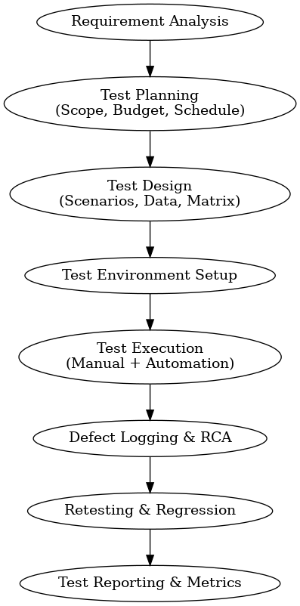
Flow Chart
By Jyotisman Kirti Prakash

Slide 9
SDLC, STLC & Agile Testing
SDLC = Full software development life cycle.
STLC = Specific process of testing lifecycle.
Agile: Testing in sprints, faster feedback loops.
The Software Development Life Cycle (SDLC) outlines how software is planned, developed, tested, and deployed. The Software Testing Life Cycle (STLC) is a subset that focuses entirely on the planning and execution of testing tasks.
Agile methodology introduces an iterative approach to testing. Rather than waiting for the entire product to be built, Agile testing happens in short cycles (sprints) that allow for continuous feedback. In the electronics domain, Agile testing ensures that firmware updates, new hardware revisions, or UI tweaks are verified frequently.
For example, a fitness band’s firmware might receive weekly updates, each tested independently within its sprint.
By Jyotisman Kirti Prakash

Slide 10
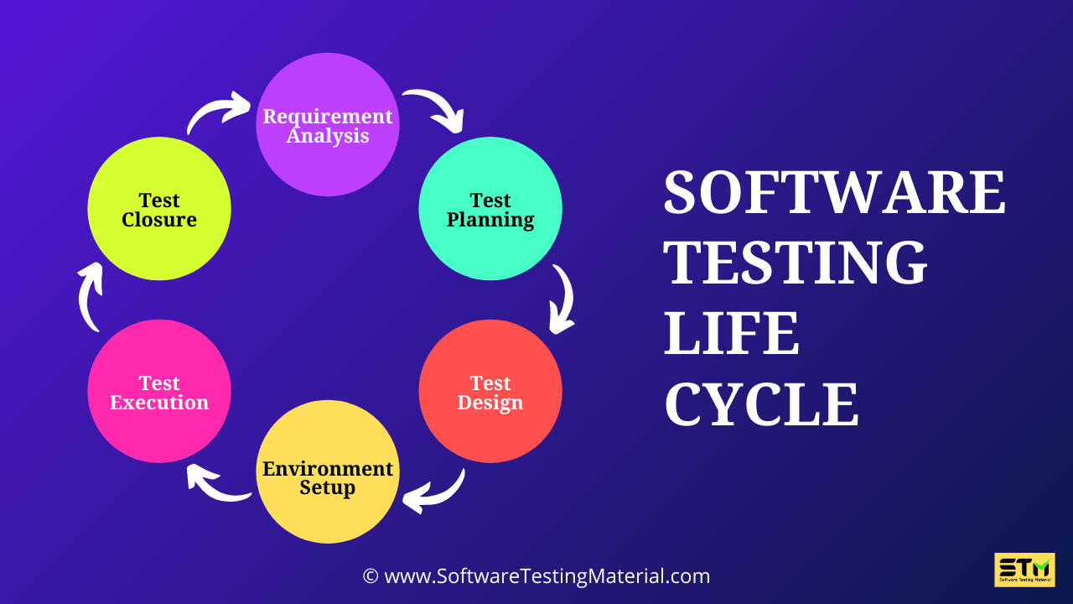
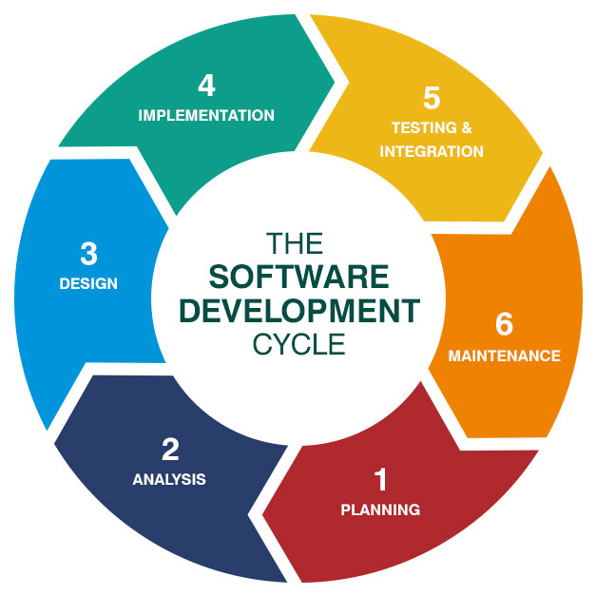
SDLC vs STLC Phases
By Jyotisman Kirti Prakash

Slide 11
Test Planning
Define scope, estimate resources, identify risks.
Produce a detailed Test Plan Document.
Example: Testing OTA firmware updates safely.
Test planning is the strategic phase where the test team defines what to test, how to test it, who will test it, and with what resources. The output is a comprehensive test plan document that outlines: - Objectives - Scope - Resources required - Risk analysis - Deliverables
For an electronic product like a smart speaker, the test plan may include scenarios for testing voice commands, network connectivity, speaker output, mobile app sync, and battery performance under different usage conditions
By Summa

Slide 12
Custom Process & Budgeting
Customize test cases as per hardware behavior.
Budget = Devices + Tools + Manpower.
Automation = Higher initial cost but long-term savings.
Every electronic product has its unique functionalities, requiring customization of test cases and tools. For instance, testing a smart lock would focus heavily on security, whereas a smart light would emphasize color accuracy and response time.
Budgeting involves forecasting costs for test tools (e.g., simulators, emulators), devices, automation infrastructure, and manpower. While automated testing may require an initial investment, it pays off by saving time and reducing manual errors over the long term.
By Summa

Slide 13
Scheduling & Risk Handling
Test schedule defines timelines for testing phases.
Risk examples: sensor delivery delays, firmware bugs.
Mitigate with simulators, mocks, backups.
Testing efforts must be carefully scheduled alongside development milestones. Delays in hardware delivery, dependencies between modules, or unexpected software bugs can disrupt schedules.
Risk management involves identifying such potential issues and preparing mitigation strategies. For example, if hardware is delayed, testers may use a hardware simulator to test the firmware in parallel, reducing overall timeline impact.
By Summa

Slide 14
Testing Techniques (Dynamic, Static, Exploratory)
Testing techniques are the methods used to verify the software. These can be broadly categorized into static and dynamic testing.
Static Testing involves reviewing the code, requirements, and documentation without executing the program. Techniques include code reviews, walkthroughs, and static analysis tools. For electronics, static testing ensures code quality before deployment.
Dynamic Testing involves executing the software on the hardware or simulators. It checks for correct behavior, performance, and reliability. For example, checking if the fitness band records accurate step count or heart rate during different activities.
Exploratory Testing allows testers to go beyond scripted test cases and explore the system to identify edge cases and unexpected behavior. This is especially useful in consumer electronics where user behavior may vary widely.
Testing Techniques
By Deepak Kumar Nayak

Slide 15
Test Coverage by Phase
By Deepak Kumar Nayak

Slide 16
Test Execution and Environment Setup
Once test cases are ready, the actual execution phase begins. Testers run manual and automated tests on target hardware or simulators. The environment setup includes:
Hardware units
Firmware versions
Connectivity setups (Wi-Fi, Bluetooth, sensors)
Software tools for logging, tracking, and reporting
Each execution must be documented with results. Any failed cases are analyzed and reported for correction. Re-testing and regression testing follow once bugs are fixed.
By Deepak Kumar Nayak

Slide 17
Defect Lifecycle and Root Cause Analysis (RCA)
Defects found during testing go through a lifecycle: identification, logging, triaging, assignment, fixing, verification, and closure. Each defect is tracked in a bug tracking system like JIRA.
Root Cause Analysis (RCA) is used to determine why the defect occurred—be it a missed requirement, code issue, or hardware integration problem. For example, if a smart thermostat keeps rebooting, RCA may reveal an issue with memory overflow triggered by certain inputs.
By Vikash

Slide 18
Defect Distribution in Testing
By Vikash

Slide 19
Metrics and Measurement
Key metrics help evaluate the quality of testing and the product:
Test Coverage: Percentage of requirements tested
Defect Density: Number of defects per module/line of code
Pass/Fail Rate: How many tests passed vs. failed
Mean Time to Detect and Fix: Efficiency of the team in resolving issues
Tracking these ensures transparency and continuous improvement.
By Vikash

Slide 20
Reporting and Communication
Effective communication between developers, testers, and product managers ensures smooth progress. Reporting includes daily/weekly updates, dashboards, bug trend analysis, and test coverage metrics.
Clear documentation helps the management take informed decisions on release readiness. Reporting tools include Excel reports, test management software (e.g., TestRail), and automated dashboards.
By Vikash

